Slide 1
학위 논문 발표
서민규

Slide 2
1. Introduction
2. Simulation Framework
3. Formulation
4. Case Study
5. Conclusion
Agenda

Slide 3
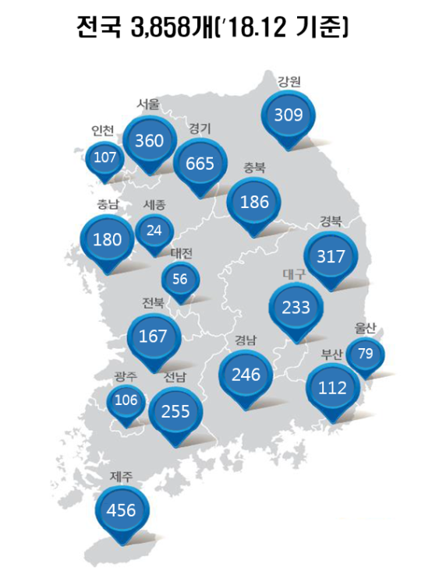
전기자동차 보급 현황 및 충전 인프라

Slide 4
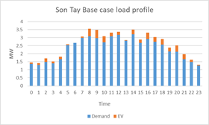
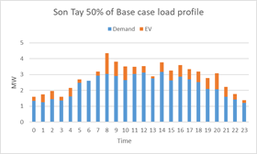
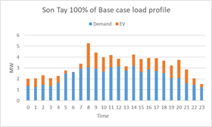
과도한 보급이 미치는 영향 ➔ V1G, V2G 제어의 필요성

Slide 5
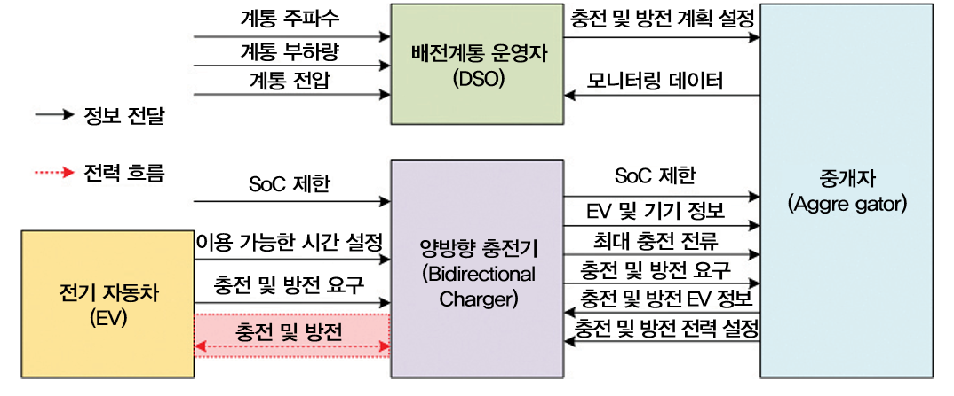
Introduction
Vehicle to Grid(V2G) 개념
전력의 흐름이 계통에서 전기자동차로 단방향으로 흐르는 것과 대조적으로 전기자동차에 저장된 전력을 계통으로 역송하는 양방향 흐름의 개념을 말함

Slide 6



Introduction
V2G Aggregator Operation
Grid Operator
Control Signal [MW]
DES States
[Hour, kW, kWh, %]
Charge / Discharge [KW]
State-of-charge
(SOC)
+ -
+ -
+ -
+ -
15 [kW] / 8 [Hours]
18 [kW] / 3 [Hours]
22 [kW] / 12 [Hours]
30 [kW] / 10 [Hours]

Slide 7

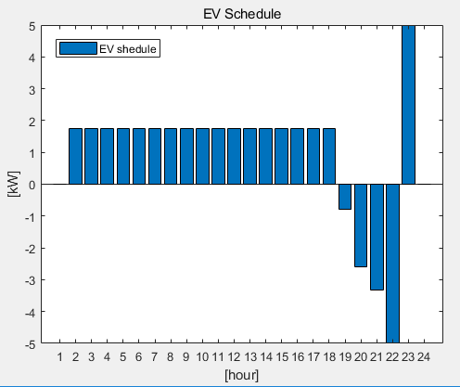



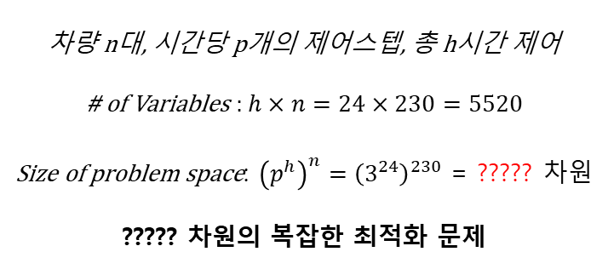

EV Fleet 최적화 방법론
어떻게 ???대에 대한 최적 충방전 스케줄을 생성할 것인가?
38.8kWh
$$\left\{\begin{matrix}Charge \\ Idle \\ Discharge\end{matrix}\right.$$
Hyundai Ioniq
Solution space: $3^{24×N}$
적합
Iterative Method
Convex Optimization
차량 n대, 시간당 p개의 제어스텝, 총 h시간 제어
# of Variables : $h×n=24×230=5520$
Size of problem space: ${\left(p^{h}\right)}^{n}={\left(3^{24}\right)}^{230}$ = ????? 차원
????? 차원의 복잡한 최적화 문제
최적화 문제 Convex화
짧은 계산 시간 소요
실시간 스케줄 보정 가능
막대한 계산 시간 소요
EV Behavior 예측의 불확실성으로 인해 실시간 스케줄 보정이 불가능

Slide 8
NP-hard란?(장기 바둑)
Convex란?

Slide 9
1. Introduction
2. Simulation Framework
3. Formulation
4. Case Study
5. Conclusion
Agenda

Slide 10


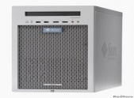
Simulation Framework
Grid Operator
+ -
Signal [MW]
30 [kW] / 10 [Hours]
Aggregator
22 [kW] / 12 [Hours]
Database
Control Server
Communication Terminal
+ -
Each Vehicles
Charge / Discharge [KW]
DES States
[Hour, Registration Number, %, Target SOC]
DES States
Registration Number | Vehicle Model | OBC Capacity | Battery Size
A0….1 | A | 30KWh | 15KWh
… | … | … | …
ZZ…9 | S | 20KWh | 20KWh
Charge / Discharge [KW]
+ -
State-of-charge
(SOC)
18 [kW] / 3 [Hours]
15 [kW] / 8 [Hours]
+ -
기본 Aggregator 모델을 반영
건물의 전기요금 최소화를 목적으로 한 전기자동차의 충방전 스케줄 생성

Slide 11
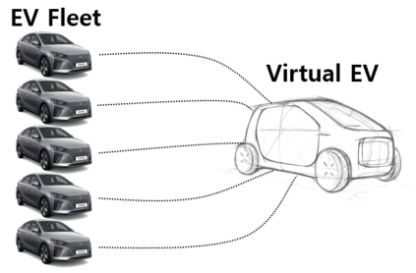

Simulation Framework
Operation Strategy
Database
Building Info - Control scheme(Objective, Operator preference) - Demand power - Appliances
EV Info - Plug time, duration - Battery status(initial SOC, capacity) - User preference
EVSE configuration - Power level - Location
EV Aggregation Cluster Model(EACM)
Multi-stage Optimization Model
Stage-A: - Virtual EV Scheduling
Stage-B: - Energy distribution (Virtual EV ➔ EVs)
Stage-A
Stage-B

Slide 12
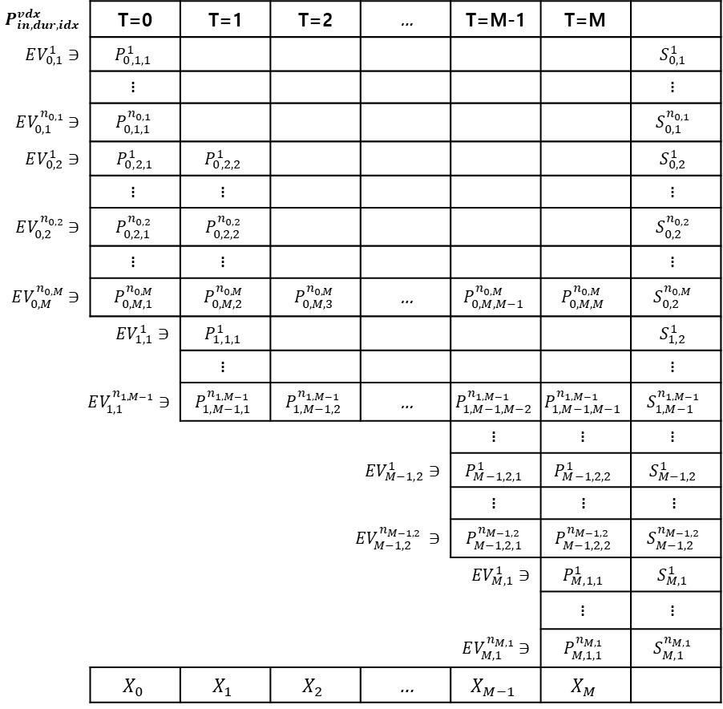
General form of EACM Primitive model
$$P_{in,dur,idx}^{vdx}$$ | T=0 | T=1 | T=2 | … | T=M-1 | T=M
$$EV_{0,1}^{1}∋$$ | $$P_{0,1,1}^{1}$$ |  |  |  |  |  | $$S_{0,1}^{1}$$
 | $$\text{፧}$$ |  |  |  |  |  | $$\text{፧}$$
$$EV_{0,1}^{n_{0,1}}∋$$ | $$P_{0,1,1}^{n_{0,1}}$$ |  |  |  |  |  | $$S_{0,1}^{n_{0,1}}$$
$$EV_{0,2}^{1}∋$$ | $P_{0,2,1}^{1}$ | $$P_{0,2,2}^{1}$$ |  |  |  |  | $$S_{0,2}^{1}$$
 | $$\text{፧}$$ | $$\text{፧}$$ |  |  |  |  | $$\text{፧}$$
$$EV_{0,2}^{n_{0,2}}∋$$ | $$P_{0,2,1}^{n_{0,2}}$$ | $$P_{0,2,2}^{n_{0,2}}$$ |  |  |  |  | $$S_{0,2}^{n_{0,2}}$$
 | $$\text{፧}$$ | $$\text{፧}$$ |  |  |  |  | $$\text{፧}$$
$$EV_{0,M}^{n_{0,M}}∋$$ | $$P_{0,M,1}^{n_{0,M}}$$ | $$P_{0,M,2}^{n_{0,M}}$$ | $$P_{0,M,3}^{n_{0,M}}$$ | … | $$P_{0,M,M−1}^{n_{0,M}}$$ | $$P_{0,M,M}^{n_{0,M}}$$ | $$S_{0,2}^{n_{0,M}}$$
 | $$EV_{1,1}^{1}∋$$ | $$P_{1,1,1}^{1}$$ |  |  |  |  | $$S_{1,2}^{1}$$
 |  | $$\text{፧}$$ |  |  |  |  | $$\text{፧}$$
$$EV_{1,1}^{n_{1,M−1}}∋$$ |  | $$P_{1,M−1,1}^{n_{1,M−1}}$$ | $$P_{1,M−1,2}^{n_{1,M−1}}$$ | … | $$P_{1,M−1,M−2}^{n_{1,M−1}}$$ | $$P_{1,M−1,M−1}^{n_{1,M−1}}$$ | $$S_{1,M−1}^{n_{1,M−1}}$$
 |  |  |  |  | $$\text{፧}$$ | $$\text{፧}$$ | $$\text{፧}$$
 |  |  | $$EV_{M−1,2}^{1}∋$$ |  | $$P_{M−1,2,1}^{1}$$ | $$P_{M−1,2,2}^{1}$$ | $$S_{M−1,2}^{1}$$
 |  |  |  |  | $$\text{፧}$$ | $$\text{፧}$$ | $$\text{፧}$$
 |  |  | $$EV_{M−1,2}^{n_{M−1,2} }∋$$ |  | $$P_{M−1,2,1}^{n_{M−1,2}}$$ | $$P_{M−1,2,2}^{n_{M−1,2}}$$ | $$S_{M−1,2}^{n_{M−1,2}}$$
 |  |  |  |  | $$EV_{M,1}^{1}∋$$ | $$P_{M,1,1}^{1}$$ | $$S_{M,1}^{1}$$
 |  |  |  |  |  | $$\text{፧}$$ | $$\text{፧}$$
 |  |  |  |  | $$EV_{M,1}^{n_{M,1}}∋$$ | $$P_{M,1,1}^{n_{M,1}}$$ | $$S_{M,1}^{n_{M,1}}$$
 | $$X_{0}$$ | $$X_{1}$$ | $$X_{2}$$ | … | $$X_{M−1}$$ | $$X_{M}$$

Slide 13
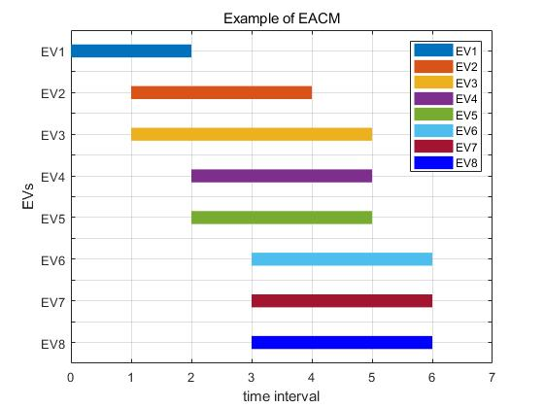
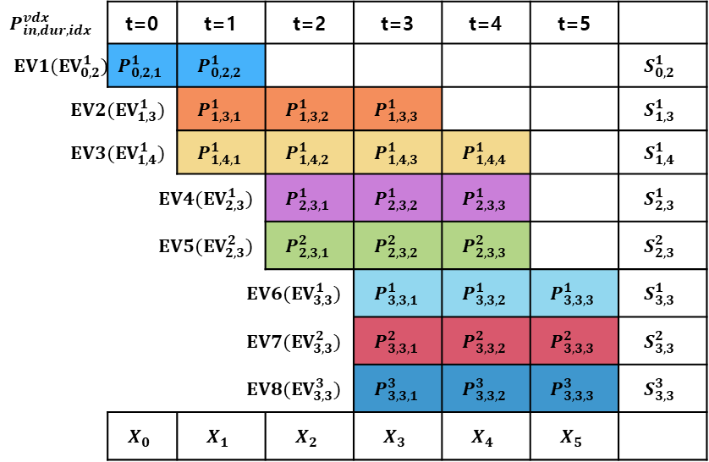
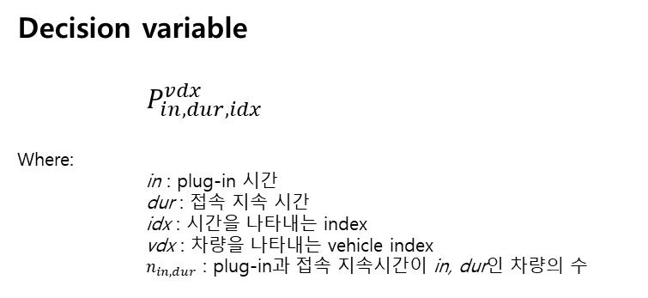
EV aggregator clustering model(EACM)
$$P_{in,dur,idx}^{vdx}$$ | t=0 | t=1 | t=2 | t=3 | t=4 | t=5
$EV1(EV_{0,2}^{1})$ | $$P_{0,2,1}^{1}$$ | $$P_{0,2,2}^{1}$$ |  |  |  |  | $$S_{0,2}^{1}$$
$EV2(EV_{1,3}^{1})$ |  | $$P_{1,3,1}^{1}$$ | $$P_{1,3,2}^{1}$$ | $$P_{1,3,3}^{1}$$ |  |  | $$S_{1,3}^{1}$$
$EV3(EV_{1,4}^{1})$ |  | $$P_{1,4,1}^{1}$$ | $$P_{1,4,2}^{1}$$ | $$P_{1,4,3}^{1}$$ | $$P_{1,4,4}^{1}$$ |  | $$S_{1,4}^{1}$$
 | $EV4(EV_{2,3}^{1})$ |  | $$P_{2,3,1}^{1}$$ | $$P_{2,3,2}^{1}$$ | $$P_{2,3,3}^{1}$$ |  | $$S_{2,3}^{1}$$
 | $EV5(EV_{2,3}^{2})$ |  | $$P_{2,3,1}^{2}$$ | $$P_{2,3,2}^{2}$$ | $$P_{2,3,3}^{2}$$ |  | $$S_{2,3}^{2}$$
 |  | $EV6(EV_{3,3}^{1})$ |  | $$P_{3,3,1}^{1}$$ | $$P_{3,3,2}^{1}$$ | $$P_{3,3,3}^{1}$$ | $$S_{3,3}^{1}$$
 |  | $EV7(EV_{3,3}^{2})$ |  | $$P_{3,3,1}^{2}$$ | $$P_{3,3,2}^{2}$$ | $$P_{3,3,3}^{2}$$ | $$S_{3,3}^{2}$$
 |  | $EV8(EV_{3,3}^{3})$ |  | $$P_{3,3,1}^{3}$$ | $$P_{3,3,2}^{3}$$ | $$P_{3,3,3}^{3}$$ | $$S_{3,3}^{3}$$
 | $$X_{0}$$ | $$X_{1}$$ | $$X_{2}$$ | $$X_{3}$$ | $$X_{4}$$ | $$X_{5}$$
Example of plug-time sample
in
out
Primitive Model
Decision variable
$P_{in,dur,idx}^{vdx}$
Where:
in : plug-in 시간
dur : 접속 지속 시간
idx : 시간을 나타내는 index
vdx : 차량을 나타내는 vehicle index
$n_{in,dur}$ : plug-in과 접속 지속시간이 in, dur인 차량의 수
Sample plug-in

Slide 14
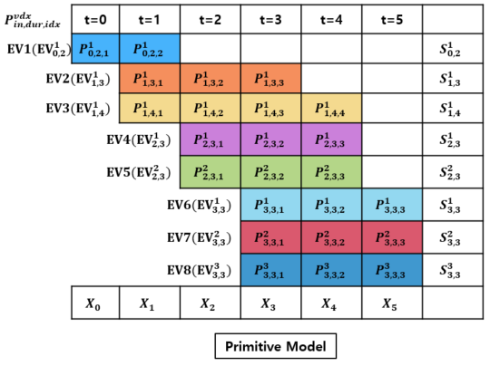
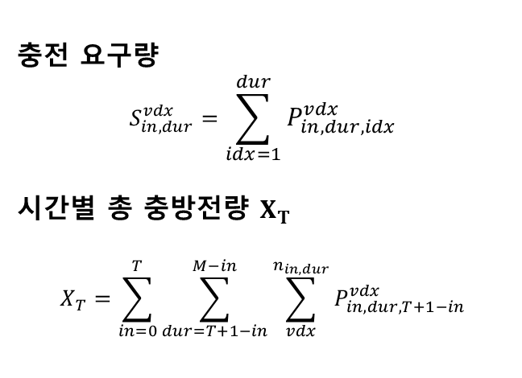

EV aggregator clustering model(EACM)
Primitive Model
충전 요구량
$$S_{in,dur}^{vdx}=\sum_{idx=1}^{dur}{P_{in,dur,idx}^{vdx}}$$
시간별 총 충방전량 $X_{T}$
$$X_{T}=\sum_{in=0}^{T}{\sum_{dur=T+1−in}^{M−in}{\sum_{vdx}^{n_{in,dur}}{P_{in,dur,T+1−in}^{vdx}}}}$$
기타 Notation
Notation | $$EV_{in,dur}^{vdx}$$ | $${IE}_{in,dur}^{vdx}$$ | $${cap}_{in,dur,idx}^{vdx}$$ | $${CP}_{in,dur,idx}^{vdx}$$ | $${DP}_{in,dur,idx}^{vdx}$$
where | EV | 초기 energy | 배터리 용량 | 최대 충전량 | 최대 방전량

Slide 15
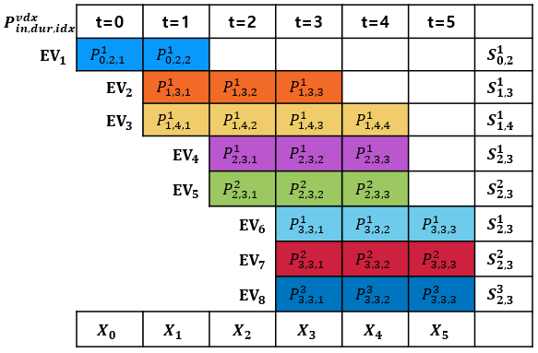
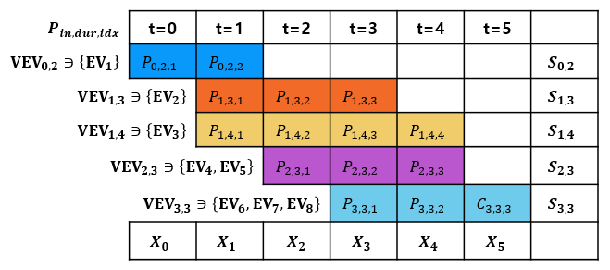
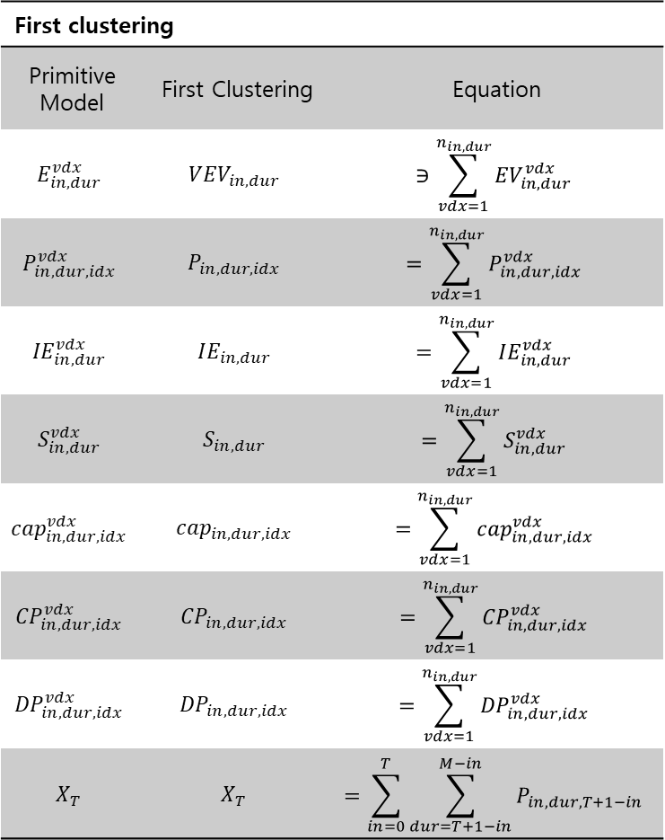
EACM First Clustering
Primitive Model
First clustering
Primitive Model | First Clustering | Equation
$$E_{in,dur}^{vdx}$$ | $${VEV}_{in,dur}$$ | $$∋\sum_{vdx=1}^{n_{in,dur}}{{EV}_{in,dur}^{vdx}}$$
$$P_{in,dur,idx}^{vdx}$$ | $$P_{in,dur,idx}$$ | $$=\sum_{vdx=1}^{n_{in,dur}}{P_{in,dur,idx}^{vdx}}$$
$${IE}_{in,dur}^{vdx}$$ | $$IE_{in,dur}$$ | $$=\sum_{vdx=1}^{n_{in,dur}}{IE_{in,dur}^{vdx}}$$
$$S_{in,dur}^{vdx}$$ | $$S_{in,dur}$$ | $$=\sum_{vdx=1}^{n_{in,dur}}{S_{in,dur}^{vdx}}$$
$${cap}_{in,dur,idx}^{vdx}$$ | $${cap}_{in,dur,idx}$$ | $$=\sum_{vdx=1}^{n_{in,dur}}{{cap}_{in,dur,idx}^{vdx}}$$
$${CP}_{in,dur,idx}^{vdx}$$ | $${CP}_{in,dur,idx}$$ | $$=\sum_{vdx=1}^{n_{in,dur}}{{CP}_{in,dur,idx}^{vdx}}$$
$${DP}_{in,dur,idx}^{vdx}$$ | $${DP}_{in,dur,idx}$$ | $$=\sum_{vdx=1}^{n_{in,dur}}{{DP}_{in,dur,idx}^{vdx}}$$
$$X_{T}$$ | $$X_{T}$$ | $$=\sum_{in=0}^{T}{\sum_{dur=T+1−in}^{M−in}{P_{in,dur,T+1−in}}}$$
Reduced vehicles with the same "connection time" and "duration time"
First clustering

Slide 16
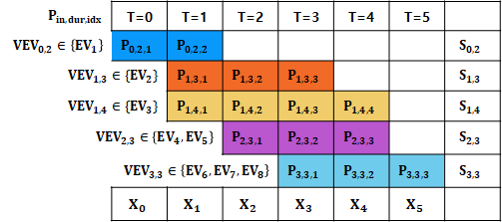
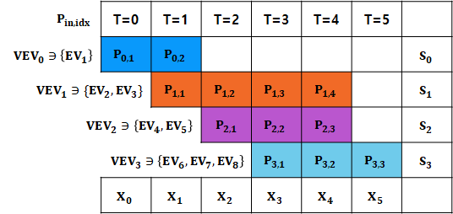
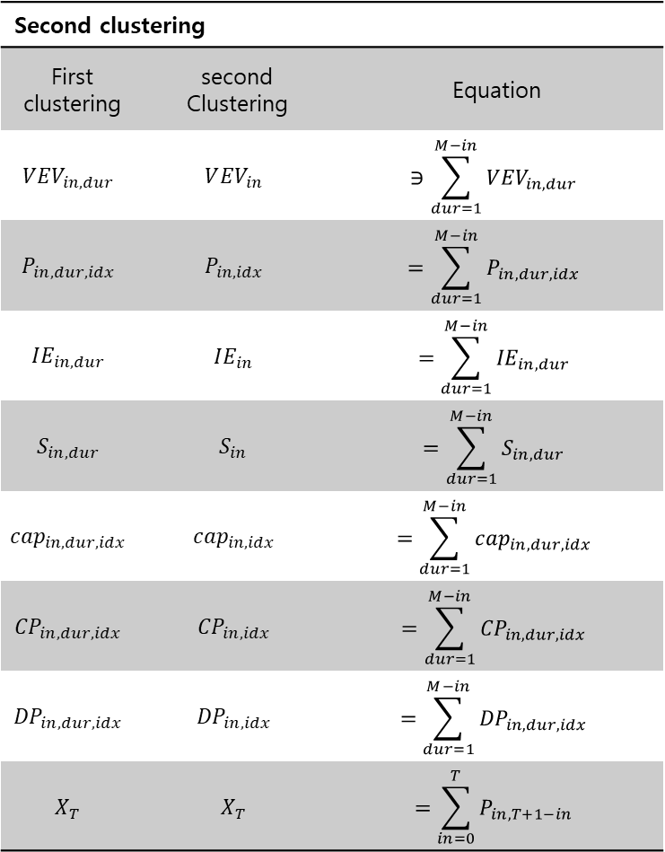
EACM Second Clustering
First Clustering
Second clustering
First clustering | second Clustering | Equation
$$V{EV}_{in,dur}$$ | $$V{EV}_{in}$$ | $$∋\sum_{dur=1}^{M−in}{{VEV}_{in,dur}}$$
$$P_{in,dur,idx}$$ | $$P_{in,idx}$$ | $$=\sum_{dur=1}^{M−in}{P_{in,dur,idx}}$$
$$IE_{in,dur}$$ | $$IE_{in}$$ | $$=\sum_{dur=1}^{M−in}{{IE}_{in,dur}}$$
$$S_{in,dur}$$ | $$S_{in}$$ | $$=\sum_{dur=1}^{M−in}{S_{in,dur}}$$
$${cap}_{in,dur,idx}$$ | $${cap}_{in,idx}$$ | $$=\sum_{dur=1}^{M−in}{{cap}_{in,dur,idx}}$$
$${CP}_{in,dur,idx}$$ | $${CP}_{in,idx}$$ | $$=\sum_{dur=1}^{M−in}{{CP}_{in,dur,idx}}$$
$${DP}_{in,dur,idx}$$ | $${DP}_{in,idx}$$ | $$=\sum_{dur=1}^{M−in}{{DP}_{in,dur,idx}}$$
$$X_{T}$$ | $$X_{T}$$ | $$=\sum_{in=0}^{T}{P_{in,T+1−in}}$$
Reduced vehicles with the same “connection time”
Second clustering

Slide 17
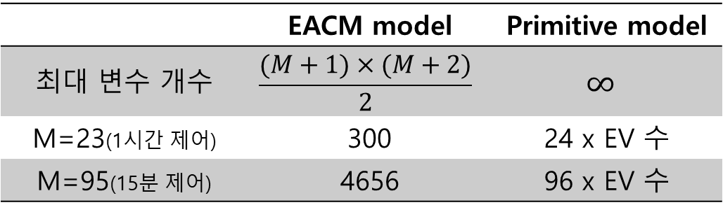
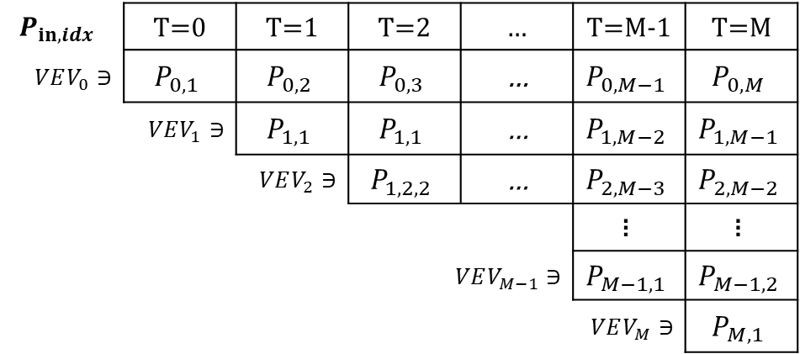
General form of EACM after Second Clustering
$$P_{in,idx}$$ | T=0 | T=1 | T=2 | … | T=M-1 | T=M
$$VEV_{0}∋$$ | $$P_{0,1}$$ | $$P_{0,2}$$ | $$P_{0,3}$$ | … | $$P_{0,M−1}$$ | $$P_{0,M}$$
 | $$VEV_{1}∋$$ | $$P_{1,1}$$ | $$P_{1,1}$$ | … | $$P_{1,M−2}$$ | $$P_{1,M−1}$$
 |  | $$VEV_{2}∋$$ | $$P_{1,2,2}$$ | … | $$P_{2,M−3}$$ | $$P_{2,M−2}$$
 |  |  |  |  | $$\text{፧}$$ | $$\text{፧}$$
 |  |  | $$VEV_{M−1}∋$$ |  | $$P_{M−1,1}$$ | $$P_{M−1,2}$$
 |  |  |  |  | $$VEV_{M}∋$$ | $$P_{M,1}$$
 | EACM model | Primitive model
최대 변수 개수 | $$\frac{(M+1)×(M+2)}{2}$$ | $$∞$$
M=23(1시간 제어) | 300 | 24 x EV 수
M=95(15분 제어) | 4656 | 96 x EV 수

Slide 18
1. Introduction
2. Simulation Framework
3. Formulation
4. Case Study
5. Conclusion
Agenda

Slide 19
Simulation Framework
Operation Strategy
Database
Building Info - Control scheme(Objective, Operator preference) - Demand power - Appliances
EV Info - Plug time, duration - Battery status(initial SOC, capacity) - User preference
EVSE configuration - Power level - Location
EV Aggregation Cluster Model(EACM)
Multi-stage Optimization Model
Stage-A: - Virtual EV Scheduling
Stage-B: - Energy distribution (Virtual EV ➔ EVs)
Stage-A
Stage-B

Slide 20
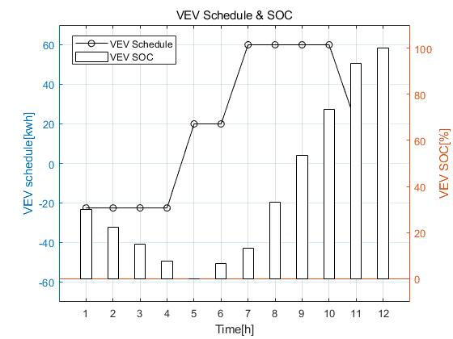
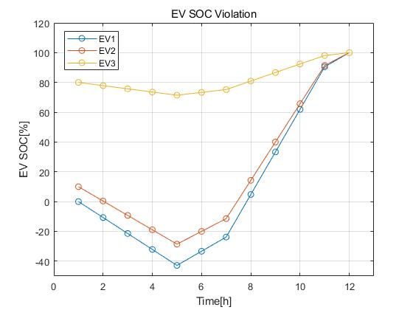
Energy distribution without Stage-B
 | Battery capacity | Initial E | Target E | Charging requirement | Upper bound | Lower bound | Plug-in
EV1 | 100 | 0 | 100 | 100 | 20 | -20 | 1~7
EV2 | 100 | 10 | 100 | 90 | 20 | -20 | 1~12
EV3 | 100 | 80 | 100 | 20 | 20 | -20 | 1~12
VEV | 300 | 90 | 100 | 210 | 60 | -60 | 1~12
TOU | t | 1 | 2 | 3 | 4 | 5 | 6 | 7 | 8 | 9 | 10 | 11 | 12
 |  | 120 | 120 | 120 | 120 | 60 | 60 | 20 | 20 | 20 | 20 | 60 | 60
Stage 1: VEV schedule
 | t | 1 | 2 | 3 | 4 | 5 | 6 | 7 | 8 | 9 | 10 | 11 | 12
 |  | -18.35 | -18.35 | -18.35 | -18.35 | 41.65 | 41.65 | 40 | 40 | 40 | 40 | 40

Slide 21
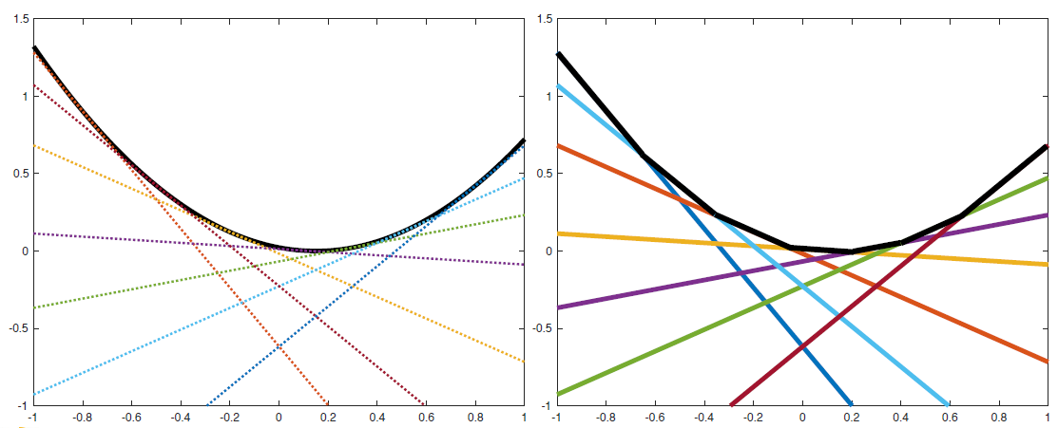
Outer approximation
제약 조건의 누적을 통해 optimal solution을 탐색
Convex function은 여러 linear function으로 근사 될 수 있음.

Slide 22


OA Motivation-1
Start
Start에서 End로 가는 최단 거리는?
장애물
장애물
장애물
End

Slide 23
OA Motivation-2
Try: 1
Try: 2
Start
장애물에 가로 막힘
Start
장애물
장애물에 가로 막힘
장애물
장애물
장애물
장애물
장애물
End
End
Try: 3
Try: 4
Start
Start
장애물
장애물
장애물
장애물
장애물에 가로 막힘
장애물에 가로 막힘
장애물
장애물
End
End

Slide 24
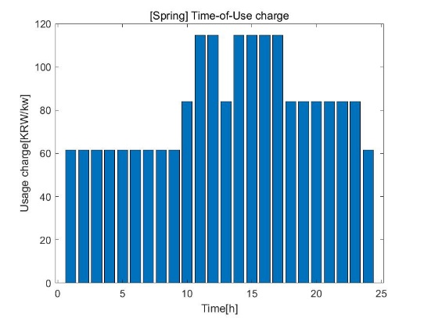
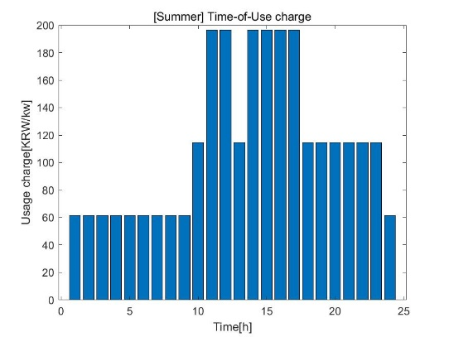

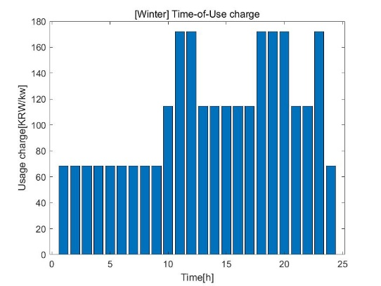
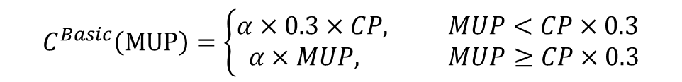
요금체제 설명
$$C^{Basic}\left(MUP\right)=\left\{\begin{aligned}&α×0.3×CP, MUP<CP×0.3 \\ & α×MUP, MUP≥CP×0.3\end{aligned}\right.$$

Slide 25
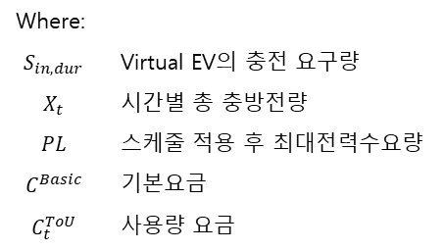
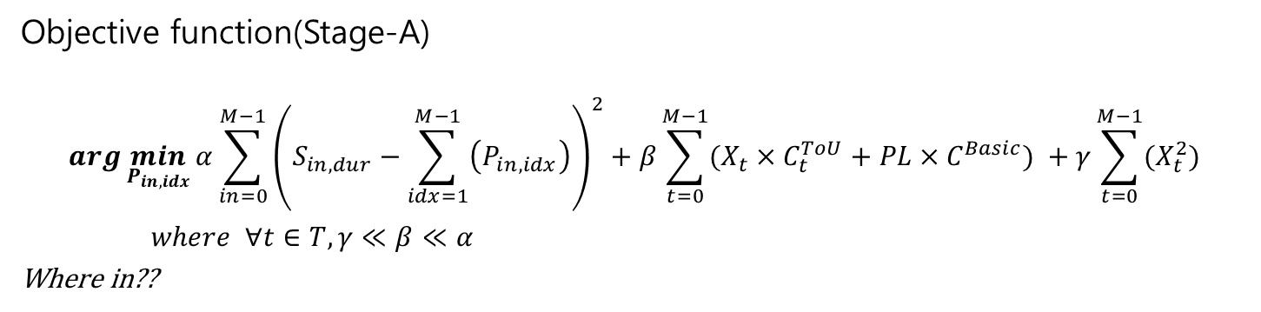
Stage-A: Objective function
Objective function(Stage-A)
$$arg\min_{P_{in, idx}}{α\sum_{in=0}^{M−1}{{\left(S_{in,dur}−\sum_{idx=1}^{M−1}{\left(P_{in,idx}\right)}\right)}^{2}}+β\sum_{t=0}^{M−1}{(X_{t}×C_{t}^{ToU}+PL×C^{Basic}) }+γ\sum_{t=0}^{M−1}{(X_{t}^{2})}}$$
$where ∀t∈T, γ≪β≪α$
Where in??
[1]
[2]
[3]
[1] : 충전요구량과 Virtual EV의 총 충전량의 차이를 최소화 → 완충 유도
[2] : 기본요금과 사용량 요금 최소화
[3] : 불필요한 충방전 제어 억제
Where:
$$S_{in,dur}$$ | Virtual EV의 충전 요구량
$$X_{t}$$ | 시간별 총 충방전량
$$PL$$ | 스케줄 적용 후 최대전력수요량
$$C^{Basic}$$ | 기본요금
$$C_{t}^{ToU}$$ | 사용량 요금

Slide 26
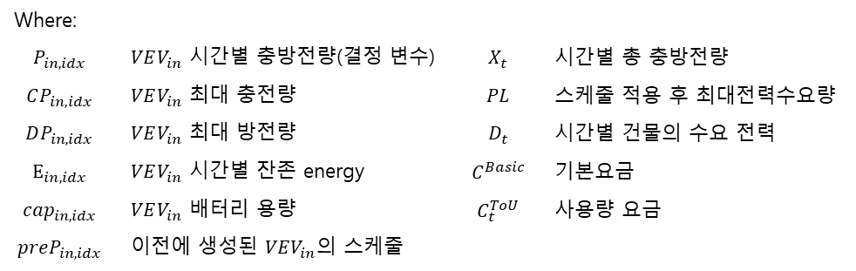
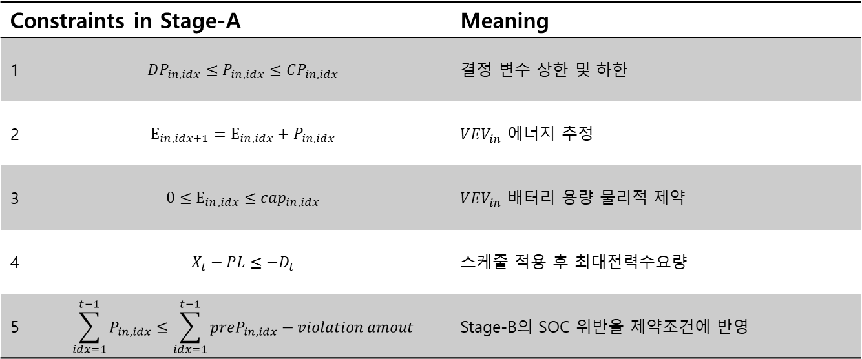
Stage-A: Constraints
Constraints in Stage-A |  | Meaning
1 | $$DP_{in,idx}≤P_{in,idx}≤CP_{in,idx}$$ | 결정 변수 상한 및 하한
2 | $$E_{in,idx+1}=E_{in,idx}+P_{in,idx}$$ | $VEV_{in}$ 에너지 추정
3 | $$0≤E_{in,idx}≤cap_{in,idx}$$ | $VEV_{in}$ 배터리 용량 물리적 제약
4 | $$X_{t}−PL≤−D_{t}$$ | 스케줄 적용 후 최대전력수요량
5 | $$\sum_{idx=1}^{t−1}{P_{in,idx}}≤\sum_{idx=1}^{t−1}{preP_{in,idx}}−violation amout$$ | Stage-B의 SOC 위반을 제약조건에 반영
Where:
$$P_{in,idx}$$ | $VEV_{in}$ 시간별 충방전량(결정 변수) | $$X_{t}$$ | 시간별 총 충방전량
$$CP_{in,idx}$$ | $VEV_{in}$ 최대 충전량 | $$PL$$ | 스케줄 적용 후 최대전력수요량
$$DP_{in,idx}$$ | $VEV_{in}$ 최대 방전량 | $$D_{t}$$ | 시간별 건물의 수요 전력
$$E_{in,idx}$$ | $VEV_{in}$ 시간별 잔존 energy | $$C^{Basic}$$ | 기본요금
$$cap_{in,idx}$$ | $VEV_{in}$ 배터리 용량 | $$C_{t}^{ToU}$$ | 사용량 요금
$$preP_{in,idx}$$ | 이전에 생성된 $VEV_{in}$의 스케줄

Slide 27


Stage-B: Objective function
Objective function(Stage-B)
$$arg\min_{P_{in,dur,idx}^{vdx}}{α\sum_{in=0}^{M−1}{\sum_{dur=1}^{M−in}{\sum_{vdx=1}^{n_{in,dur}}{{\left\{cap_{in,dur}^{vdx}−FE_{in,dur}^{vdx}\right\}}^{2}}+β\sum_{in=0}^{M−1}{\sum_{dur=1}^{M−in}{\sum_{vdx=1}^{n_{in,dur}}{{\left\{{ToE}_{in,dur}^{vdx}\right\}}^{2}}}}+γ\sum_{t=1}^{M}{(X_{t}^{2})}}}}$$
$where ∀t∈T, γ≪β≪α$
[1]
[2]
[3]
[1] : 충전요구량과 Virtual EV의 총 충전량의 차이를 최소화 → 완충 유도
[2] : 잔존 에너지량 $E_{in,dur}^{vdx}$에
[3] : 불필요한 충방전 제어 억제(smoothing)
Where:
$$S_{in,dur}$$ | Virtual EV의 충전 요구량
$$X_{t}$$ | 시간별 총 충방전량
$$PL$$ | 스케줄 적용 후 최대전력수요량
$$C^{Basic}$$ | 기본요금
$$C_{t}^{ToU}$$ | 사용량 요금

Slide 28
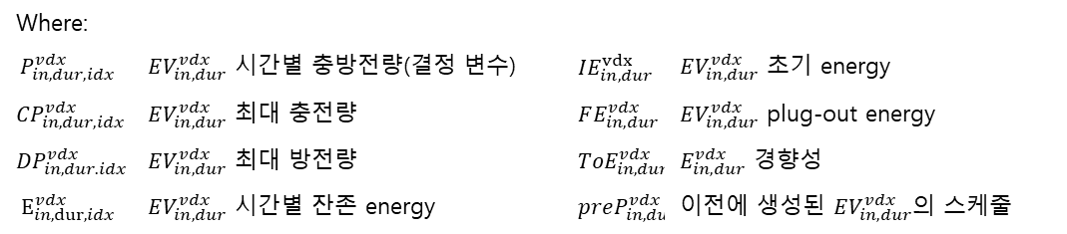
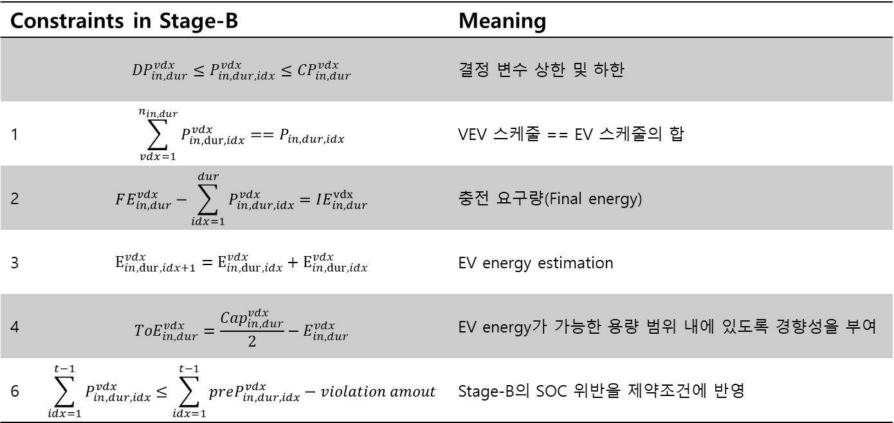
Stage-B: Constraints
Constraints in Stage-B |  | Meaning
 | $${DP}_{in,dur}^{vdx}≤P_{in,dur,idx}^{vdx}≤{CP}_{in,dur}^{vdx}$$ | 결정 변수 상한 및 하한
1 | $$\sum_{vdx=1}^{n_{in,dur}}{P_{in,dur,idx}^{vdx}}==P_{in,dur,idx}$$ | VEV 스케줄 == EV 스케줄의 합
2 | $$FE_{in,dur}^{vdx}−\sum_{idx=1}^{dur}{P_{in,dur,idx}^{vdx}}=IE_{in,dur}^{vdx}$$ | 충전 요구량(Final energy)
3 | $$E_{in,dur,idx+1}^{vdx}=E_{in,dur,idx}^{vdx}+E_{in,dur,idx}^{vdx}$$ | EV energy estimation
4 | $${ToE}_{in,dur}^{vdx}=\frac{Cap_{in,dur}^{vdx}}{2}−E_{in,dur}^{vdx}$$ | EV energy가 가능한 용량 범위 내에 있도록 경향성을 부여
6 | $$\sum_{idx=1}^{t−1}{P_{in,dur,idx}^{vdx}}≤\sum_{idx=1}^{t−1}{preP_{in,dur,idx}^{vdx}}−violation amout$$ | Stage-B의 SOC 위반을 제약조건에 반영
Where:
$$P_{in,dur,idx}^{vdx}$$ | $EV_{in,dur}^{vdx}$ 시간별 충방전량(결정 변수) | $$IE_{in,dur}^{vdx}$$ | $EV_{in,dur}^{vdx}$ 초기 energy
$${CP}_{in,dur,idx}^{vdx}$$ | $EV_{in,dur}^{vdx}$ 최대 충전량 | $$FE_{in,dur}^{vdx}$$ | $EV_{in,dur}^{vdx}$ plug-out energy
$${DP}_{in,dur.idx}^{vdx}$$ | $EV_{in,dur}^{vdx}$ 최대 방전량 | $${ToE}_{in,dur}^{vdx}$$ | $E_{in,dur}^{vdx}$ 경향성
$$E_{in,dur,idx}^{vdx}$$ | $EV_{in,dur}^{vdx}$ 시간별 잔존 energy | $$preP_{in,dur,idx}^{vdx}$$ | 이전에 생성된 $EV_{in,dur}^{vdx}$의 스케줄

Slide 29
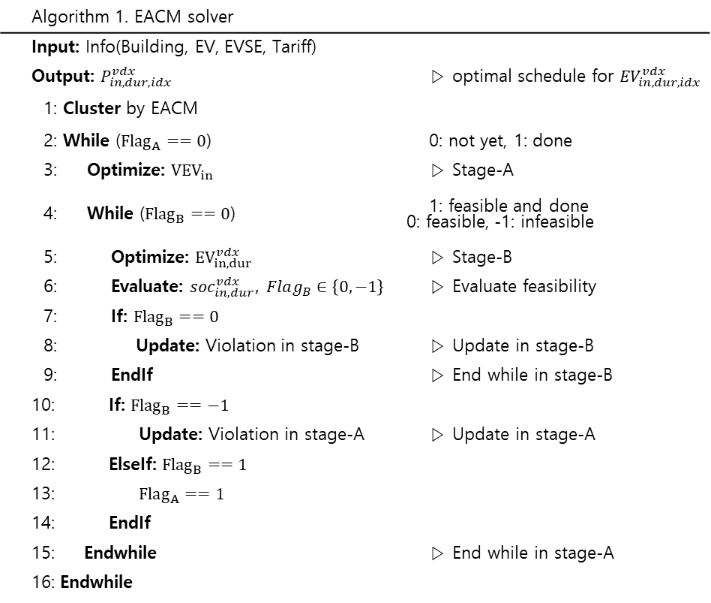
Algorithm of Multi-stage optimization
Algorithm 1. EACM solver
Input: Info(Building, EV, EVSE, Tariff)
Output: $P_{in,dur,idx}^{vdx}$ | ▷ optimal schedule for ${EV}_{in,dur,idx}^{vdx}$
1: Cluster by EACM
2: While (${Flag}_{A}==0$) | 0: not yet, 1: done
3: Optimize: ${VEV}_{in}$ | ▷ Stage-A
4: While (${Flag}_{B}==0$) | 1: feasible and done 0: feasible, -1: infeasible
5: Optimize: ${EV}_{in,dur}^{vdx}$ | ▷ Stage-B
6: Evaluate: ${soc}_{in,dur}^{vdx}, Flag_{B}∈\left\{0,−1\right\}$ | ▷ Evaluate feasibility
7: If: ${Flag}_{B}==0$
8: Update: Violation in stage-B | ▷ Update in stage-B
9: EndIf | ▷ End while in stage-B
10: If: ${Flag}_{B}==−1$
11: Update: Violation in stage-A | ▷ Update in stage-A
12: ElseIf: ${Flag}_{B}==1$
13: $Flag_{A}==1$
14: EndIf
15: Endwhile | ▷ End while in stage-A
16: Endwhile

Slide 30
1. Introduction
2. Simulation Framework
3. Formulation
4. Case Study
5. Conclusion
Agenda

Slide 31
Model Validation-1
Test case
 | Battery capacity | Initial E | Target E | Charging requirement | Upper bound | Lower bound | Plug-in
EV1 | 100 | 0 | 100 | 100 | 20 | -20 | 1~7
EV2 | 100 | 10 | 100 | 90 | 20 | -20 | 1~12
EV3 | 100 | 80 | 100 | 20 | 20 | -20 | 1~12
VEV | 300 | 90 | 100 | 210 | 60 | -60 | 1~12
TOU | t | 1 | 2 | 3 | 4 | 5 | 6 | 7 | 8 | 9 | 10 | 11 | 12
 |  | 120 | 120 | 120 | 120 | 60 | 60 | 20 | 20 | 20 | 20 | 60 | 60
Optimal solution | t | 1 | 2 | 3 | 4 | 5 | 6 | 7 | 8 | 9 | 10 | 11 | 12
EV1 스케줄 |  | 15 | 15 | 15 | 15 | 20 | 20 | - | - | - | - | - | -
EV2 스케줄 |  | -2.5 | -2.5 | -2.5 | -2.5 | 6.66 | 6.66 | 20 | 20 | 20 | 20 | 6.66 | -
EV3 스케줄 |  | -20 | -20 | -20 | -20 | 6.66 | 6.66 | 20 | 20 | 20 | 20 | 6.66 | -
EV1 SOC |  | 0 | 15 | 29.99 | 44.99 | 59.99 | 79.99 | 99.99 | - | - | - | - | -
EV2 SOC |  | 10 | 7.5 | 5 | 2.5 | 0 | 6.66 | 13.33 | 33.33 | 53.33 | 73.33 | 93.33 | 99.99
EV3 SOC |  | 80 | 60 | 40 | 20 | 0 | 6.66 | 13.33 | 33.33 | 53.33 | 73.33 | 93.33 | 99.99
Proposed solution | t | 1 | 2 | 3 | 4 | 5 | 6 | 7 | 8 | 9 | 10 | 11 | 12
EV1 스케줄 |  | 14.57 | 14.77 | 15.072 | 15.07 | 20 | 20 | - | - | - | - | - | -
EV2 스케줄 |  | -3.23 | -3.33 | -3.09 | -0.32 | 3.16 | 3.16 | 20 | 20 | 20 | 20 | 13.1619 | -
EV3 스케줄 |  | -16.22 | -16.32 | -16.85 | -19.62 | -0.48 | -0.48 | 20 | 20 | 20 | 20 | 9.511435 | -
EV1 SOC |  | 0 | 14.58 | 29.35 | 44.42 | 59.49 | 79.49 | 99.49 | 0 | 0 | 0 | 0 | 0
EV2 SOC |  | 10 | 6.77 | 3.44 | 0.34 | 0.01 | 3.17 | 6.33 | 26.33 | 46.33 | 66.33 | 86.33 | 99.49
EV3 SOC |  | 80 | 63.77 | 47.45 | 30.59 | 10.96 | 10.47 | 9.98 | 29.98 | 49.98 | 69.98 | 89.98 | 99.49
 | TOU Cost | Cost gap[won] | Cost gap[%] | Charging amount[kwh]
Optimal | 4749.5 | 187.5 | 3.79 | 209.9600
Proposed | 4937 |  |  | 208.4800

Slide 32
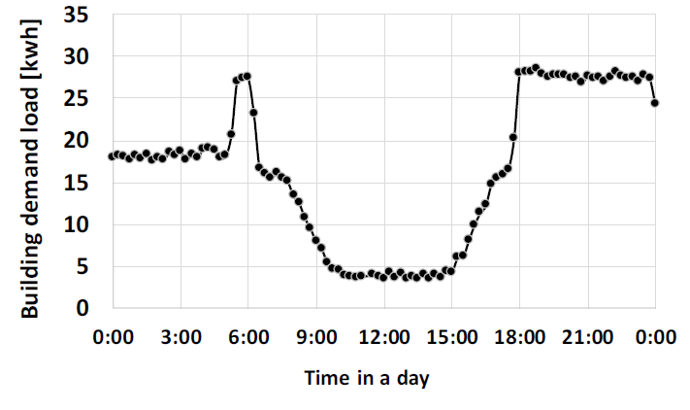
Case Study
Simulation Condition
Simulation 환경 설명(진흥원)

Slide 33
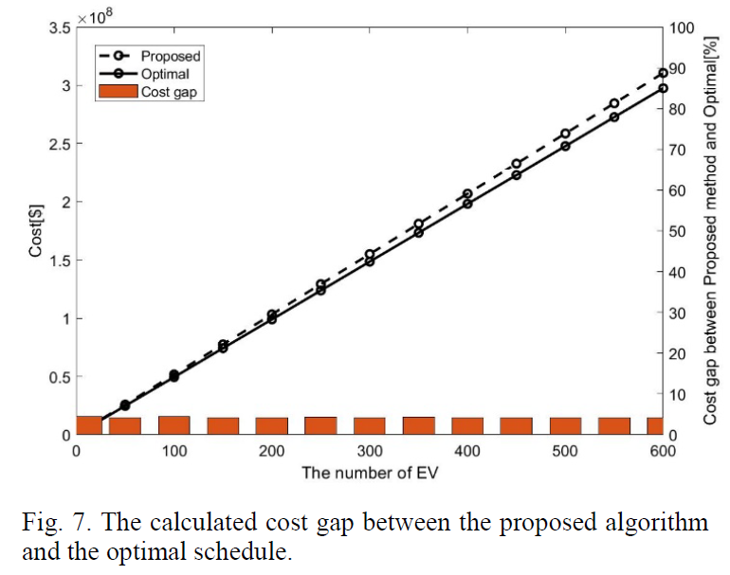
Case Study
Simulation Result
결과 설명

Slide 34
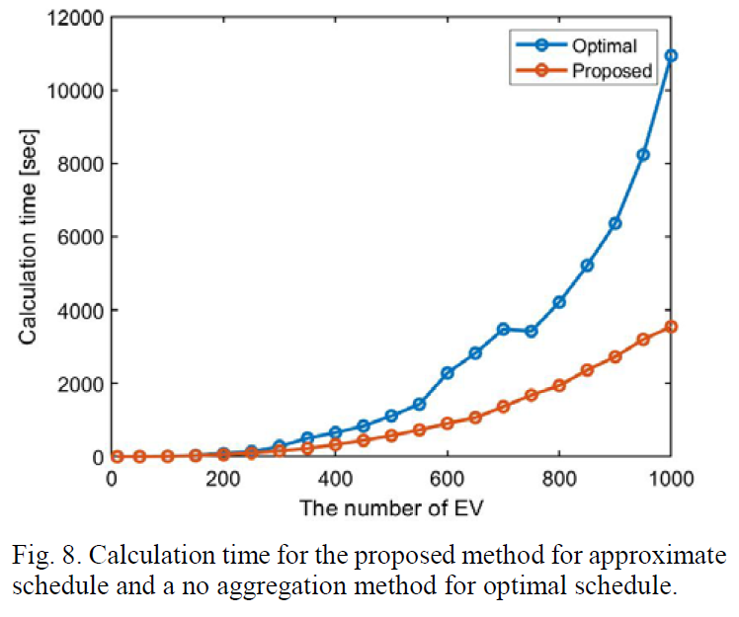
Case Study
Simulation Result
결과 설명

Slide 35
1. Introduction
2. Simulation Framework
3. Formulation
4. Case Study
5. Conclusion
Agenda

Slide 36
결론
This study proposes a method to aggregate individual EVs into virtual EVs, which are called EACM. In addition, a multi-stage optimization method is also proposed. The EACM and proposed multi-stage optimization method reduce the decision variables while considering SoC constraints for all individual EVs. As a result, the computational time is reduced and obtained schedules for individual EVs, allows for near minimal cost, which is validated by the simulation. In the simulation, the computational time using the proposed methods are 32%of the conventional method with 1,000 EVs. The cost gap between an optimal EV charging schedule and an approximated one obtained by the proposed method is less than 5% regardless of the number of EVs.

Slide 37
연구실적
Conference
Quantile regression에 기초한 배전 부하 경향 분석, 대한전기학회 춘계학술대회, 2018.04
Peak shaving of an EV Aggregator Using Quadratic Programming, 2019 IEEE PES ISGT, 2019.05
Reduction of Computational Complexity for Optimal Electric Vehicle Schedulings, 2020 IEEE PESGM, 2020.08
특허
지역 단위 파워 모빌리티 서비스 제공방법, 이를 수행하기 위한 파워모빌리티 관리서버 및 이를 포함하는 지역 단위 파워 모빌리티 시스템
출원번호 : 10-2018-0067339
건물 단위 파워 모빌리티 서비스 제공방법, 이를 수행하기 위한 건물 에너지 관리장치 및 이를 포함하는 건물 단위 파워 모빌리티 시스템
출원번호 : 10-2018-0067338
대규모 plug-in 전기차 집합 제어를 위한 방법 및 장치
출원 진행중

Slide 38
Q&A
Q&A

